Slide 1
In His Name
Interactive Learning Course Final Project:
Policy-Based Reward Estimation for Expert-Driven Social Learning in Multi-Agent Systems
Professor:
Prof. Majid Nili Ahmadabadi
Writers:
Soleiman B.Ganji, Nikoo Paknia

Slide 2
Lunar Lander v2 as the environment

Slide 3
Social learning problem agents
An expert agent trained with Q-learning
An agent with random policy
A social agent

Slide 4
Social learning problem definition
If the social agent has the expert’s policy, the social one should learn from the expert, but how?
The social agent has access to state-action pairs of the expert, not its policy, how can it learn from this data?
In reality no one tells the social agent who is the expert, how should it find the expert?

Slide 5
We first need an expert
Since we employ a policy-based algorithm for the social agent we opted for a value-based approach for the expert agent to mitigate potential bias.
We selected Deep Q-Learning (DQN) as the expert’s learning algorithm with epsilon greedy.

Slide 6
Expert’

Slide 7
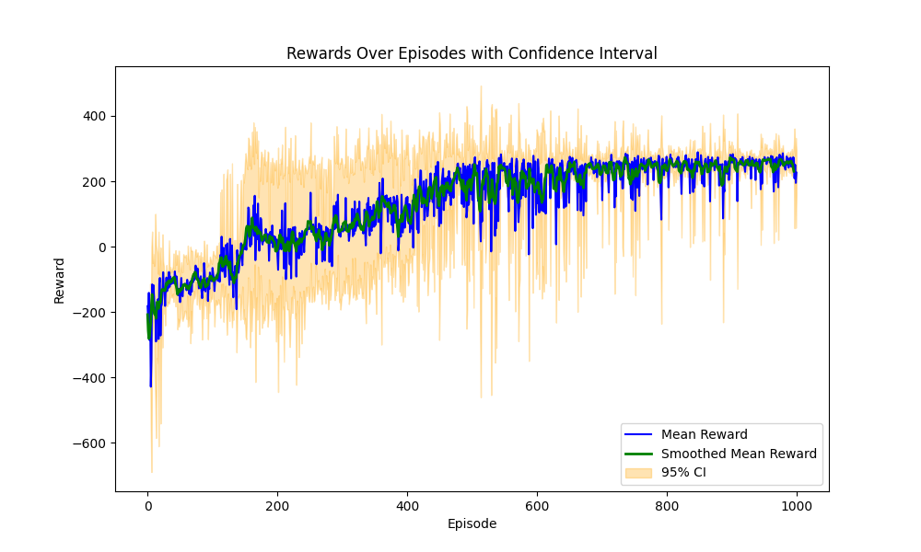
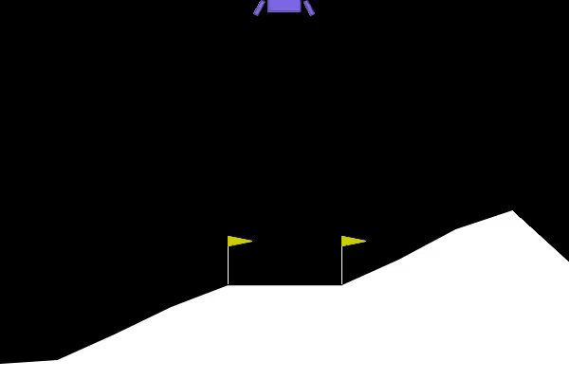
Expert’s results

Slide 8
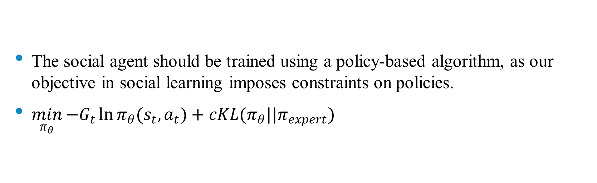
Social agent’s objective
The social agent should be trained using a policy-based algorithm, as our objective in social learning imposes constraints on policies.
$\min_{π_{θ}}{−G_{t}\ln{π_{θ}(s_{t},a_{t})}}+cKL(π_{θ}||π_{expert})$

Slide 9
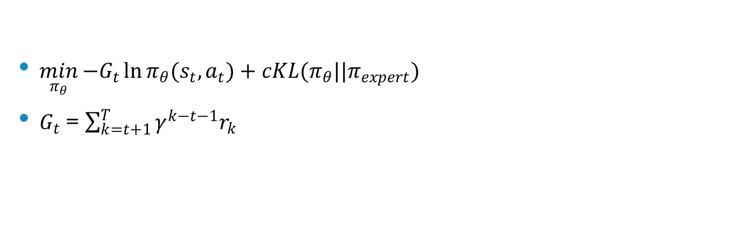
REINFORCE algorithm for the social agent
$\min_{π_{θ}}{−G_{t}\ln{π_{θ}(s_{t},a_{t})}}+cKL(π_{θ}||π_{expert})$
$G_{t}$ = $\sum_{k=t+1}^{T}{γ^{k−t−1}r_{k}}$

Slide 10
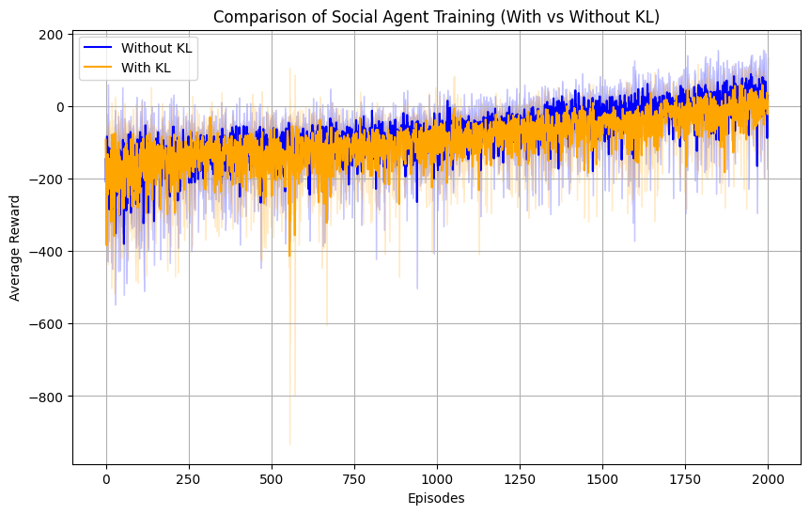
Results and effects of social learning

Slide 11
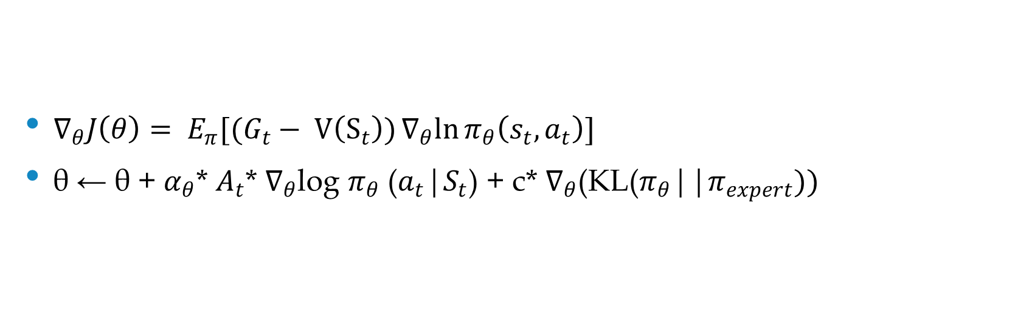
REINFORCE with baseline for the social agent
$∇_{θ}J\left(θ\right)= E_{π}[(G_{t}− V\left(S_{t}\right))∇_{θ}ln{π_{θ}\left(s_{t},a_{t}\right)}]$
θ ← θ + $α_{θ}$* $A_{t}$* $∇_{θ}$log $π_{θ}$ ($a_{t}$|$S_{t}$) + c* $∇_{θ}$(KL($π_{θ}$||$π_{expert}))$

Slide 12
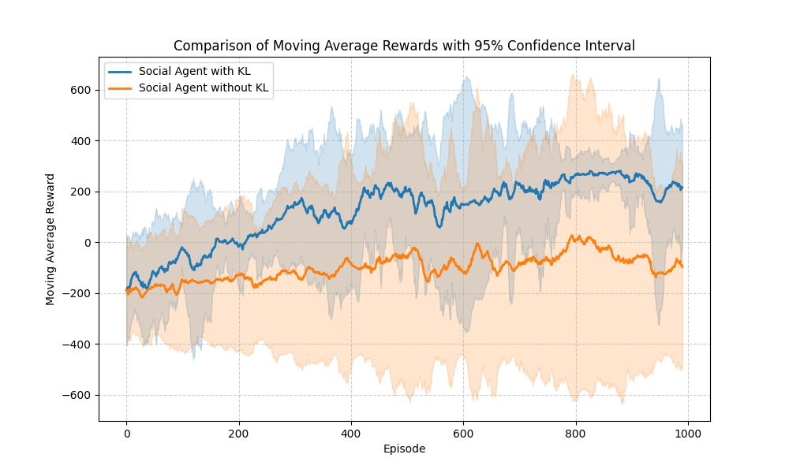
Results and effects of social learning

Slide 13
Policy estimator network
To address the absence of directly accessible policies, we propose a policy estimator network that learns to approximate the expert agent’s policy from observed state-action pairs.

Slide 14
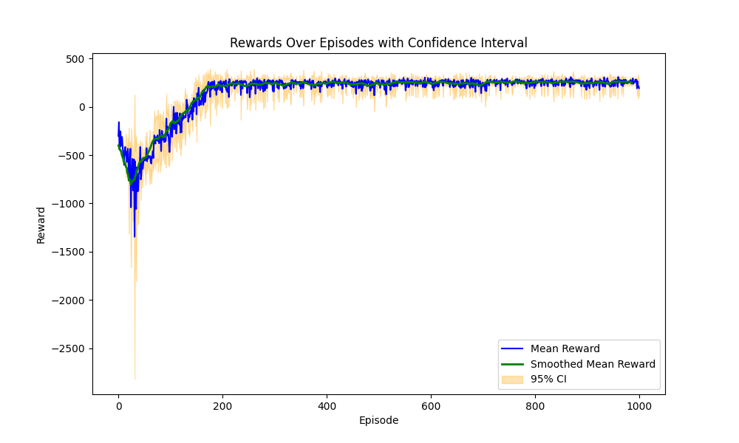
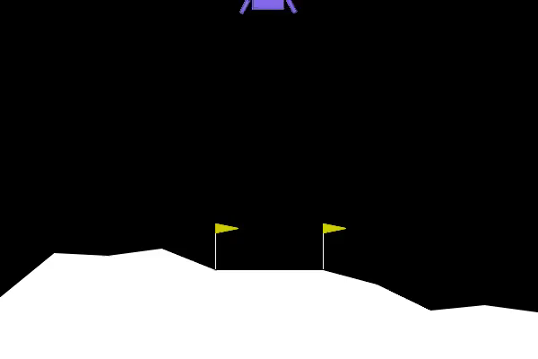
Policy estimator in KL loss

Slide 15
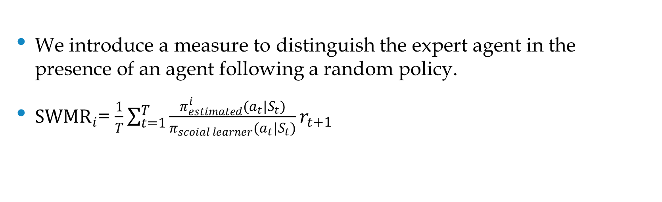
A meter to find the expert
We introduce a measure to distinguish the expert agent in the presence of an agent following a random policy.
${SWMR}_{i}$= $\frac{1}{T}\sum_{t=1}^{T}{\frac{π_{estimated}^{i}(a_{t}|S_{t})}{π_{scoial learner}(a_{t}|S_{t})}}r_{t+1}$

Slide 16
Using the defined meter, policy estimators and KL term for social learning

Slide 17
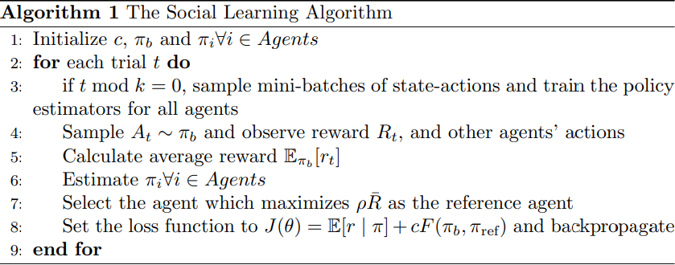
The algorithm

Slide 18
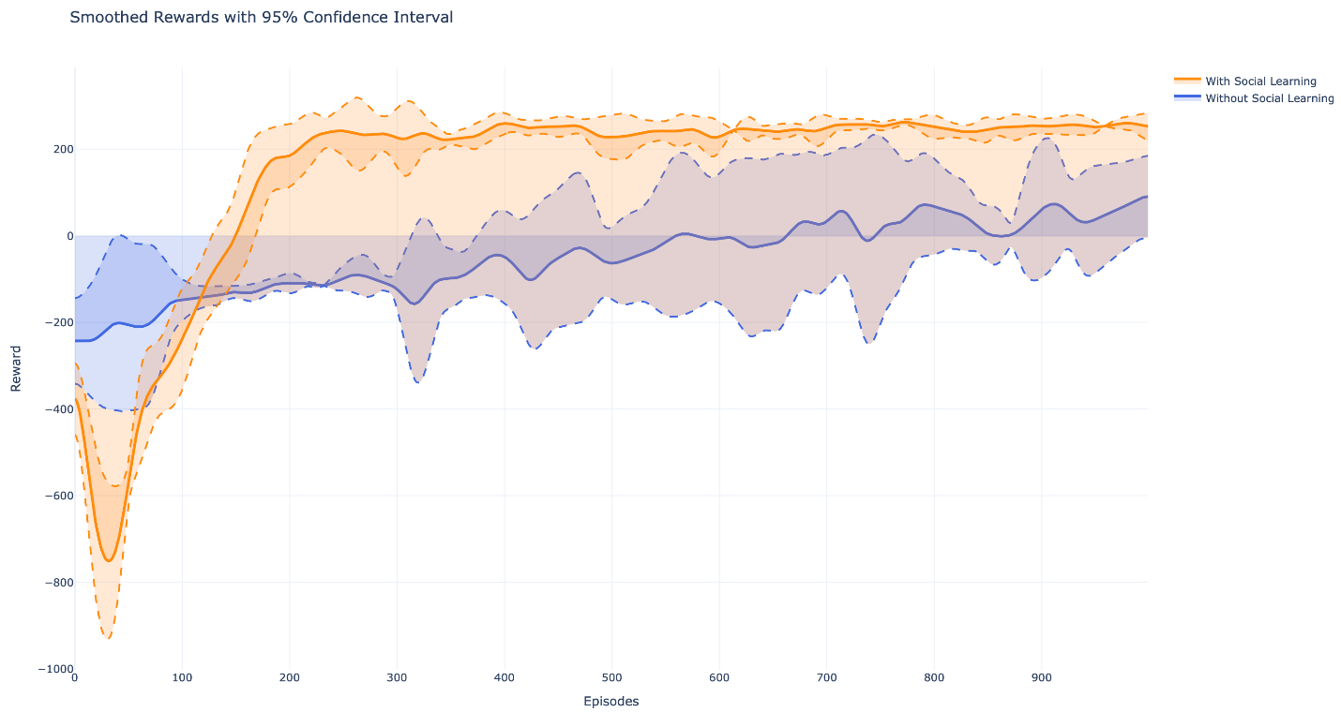
How this approach helped our agent

Slide 19
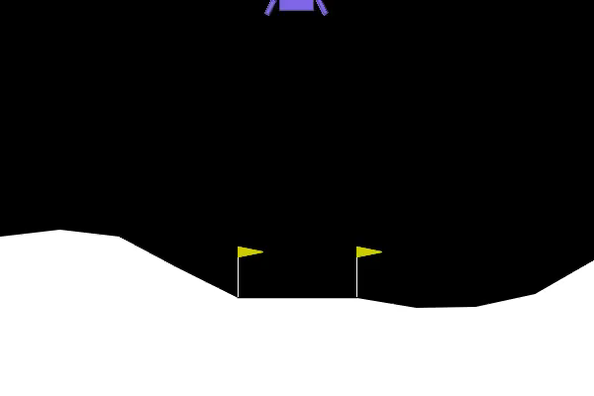
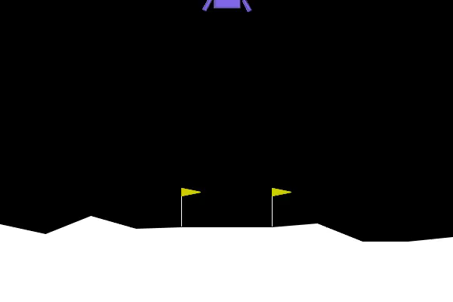
Effect of our approach on REINFORCE with baseline agent
The agent alone
Using this approach

Slide 20
Thanks for your attention

